Slide 1
Kindergarten Orientation
Assiniboine Elementary School
2022 - 2023

Slide 2
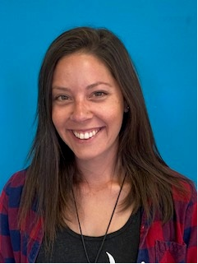
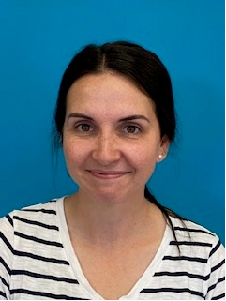
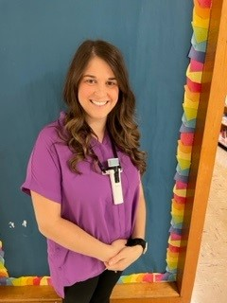
Welcome To Kindergarten
Mrs. Libby
Ms. Wilkie
We are so excited to meet you and learn with you this year!!
Kindergarten Team
2021-2022
Mrs. Shanks
Mrs. Fraser

Slide 3
Before the first week…
Sept 1 (6-7 pm) – Parent Information Night

Slide 4
Staggered Entry
Students only come on Tuesday OR Wednesday. You will sign up for a day when you come to Parent Information Night in August.
Arrival at 9am –Students and parent will wait outside at the office doors.
Teacher will come out at 9am to welcome everyone and bring them to the classroom.
Parents are welcome to stay for up to 20 minutes. Please exit through the main entrance.
Dismissal at 2:00 pm
Everyone comes Thursday (8:00-2:00) and Friday (8:00– 12:00)

Slide 5
Bus Students
During Parent Information Night you will be asked provide the following info:
AM bus #
PM bus #
Friday bus #
Include physical address to where your child is going afterschool. Ex: Fitkids, or if home, your street address
On your child’s backpack, please include:
Luggage tag with AM, PM, Friday bus #and address (or daycare center)
On the first day of school we will attach a colored ribbon to your child’s bookbag to help the bus drivers know they’re from our school quickly.

Slide 6
Walkers/Pick up Students
Please have the following info on Parent Information Night:
If they will be dropped off in the morning
Who is picking them up after school
Please note drop off time is between 8:00-8:20 at the parent parking lot area. Your child will be met by a duty teacher and go directly into the school.
Dismissal Mon- Thurs is 2:00 at the parent parking lot.
Friday dismissal is at 12:00 at the parent parking lot.

Slide 7
What Students Need
Indoor Shoes: Velcro only. Please do not send lace up or light up shoes. These will be kept at school. Please label.
Water bottle: Please label and send a filled one each day.
Extra clothes: change of clothes in plastic bag to be kept in bottom of bookbag.
Lunch & Snacks : These need to be nut free, please provide utensils daily if needed and ready to eat ( we are unable to heat up food).

Slide 8
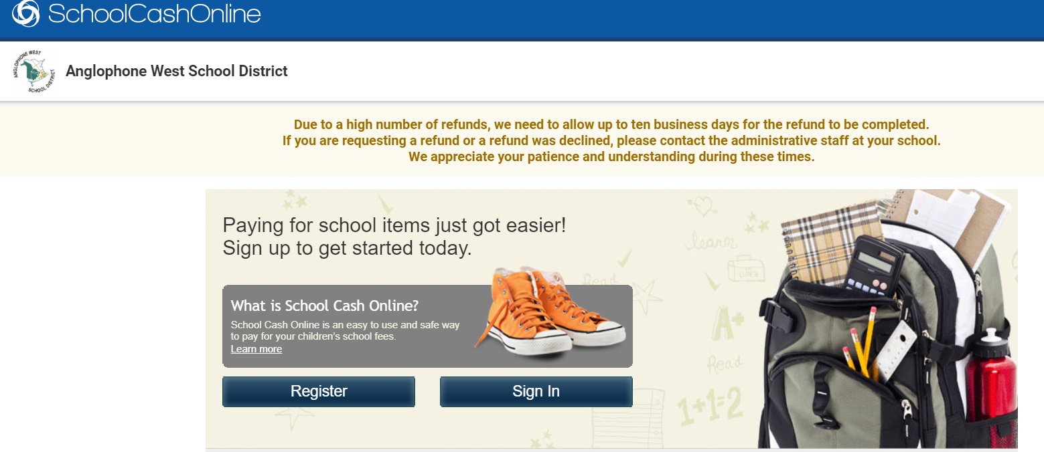
School Supplies
$40 supply fee
$10 agenda fee
Click here to sign up for Cashless School
https://anglophonewest.schoolcashonline.com/

Slide 9
Drop off 8:00-8:20 Snack Recess Lunch Recess Eat Lunch Dismissal 2:00 Friday dismissal 12:00
Typical Day in the life of Kindergarten!
Literacy
Numeracy
Exploration Time
Art
School Library
Music
Physical Education
Outdoor Learning ( when possible)
* Lunches/Snacks: nut free and ready to eat
*Promote independence
* Outside Recesses: dress for the weather ☺

Slide 10
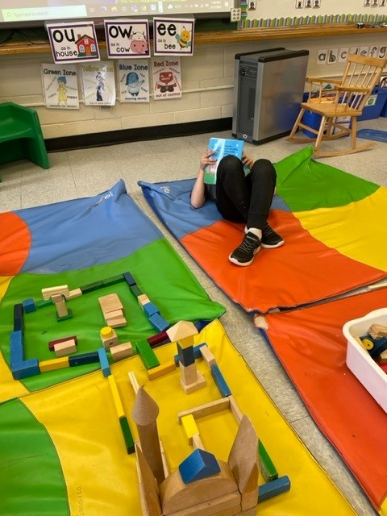
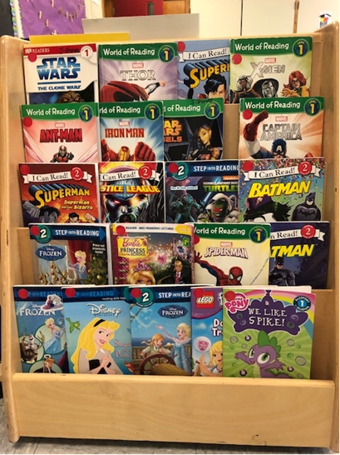
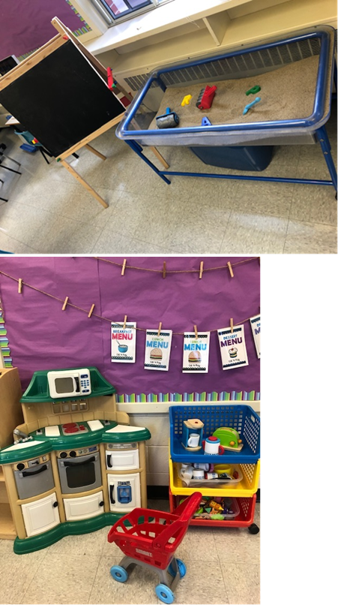
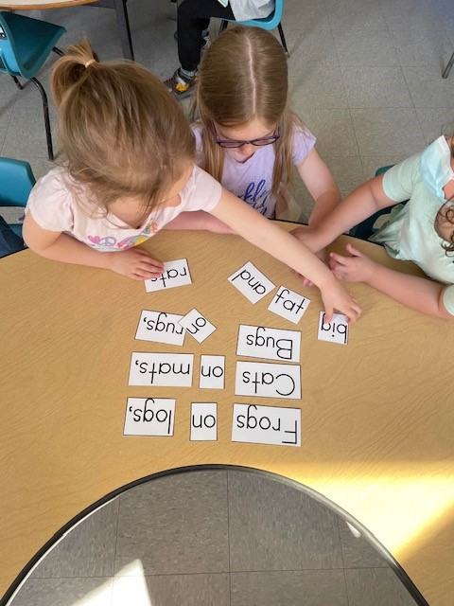
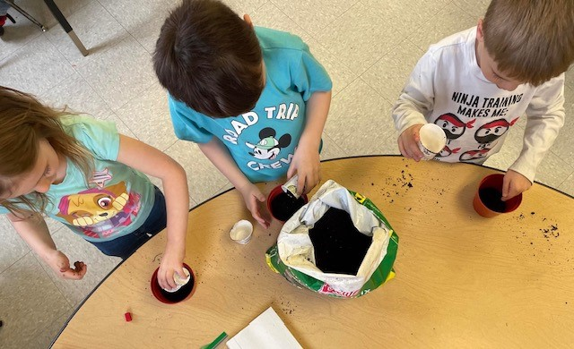
Classroom Learning in Kindergarten!

Slide 11
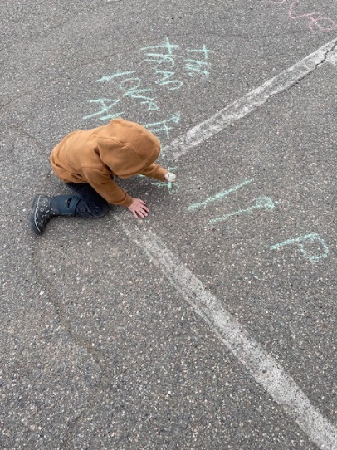
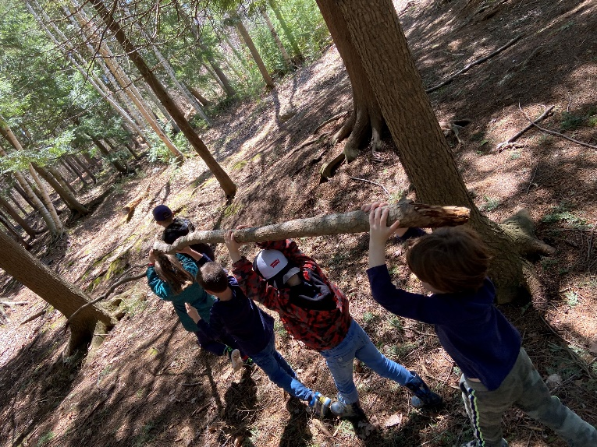
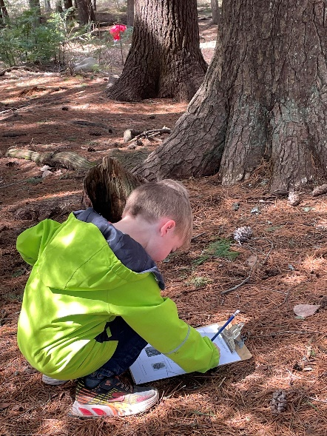
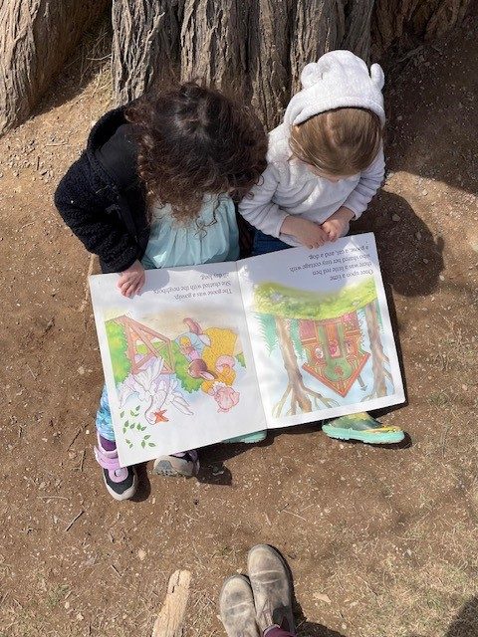
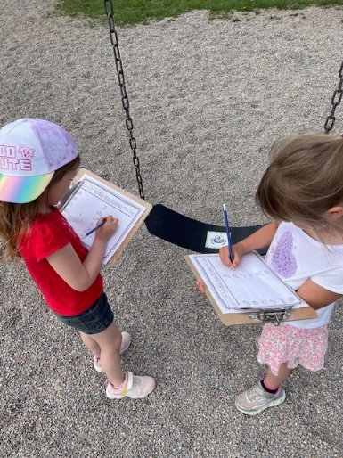
Outdoor Learning in Kindergarten!

